Slide 1
CEPT Portal
CEPT Workshop on European Spectrum Management and Numbering
4th June 2014

Slide 2
CEPT portal
One portal: 5 websites (CEPT, CERP, Com-ITU, ECC, ECO)
Most of the information publicly available
Advanced features restricted to group members
Get a login

Slide 3
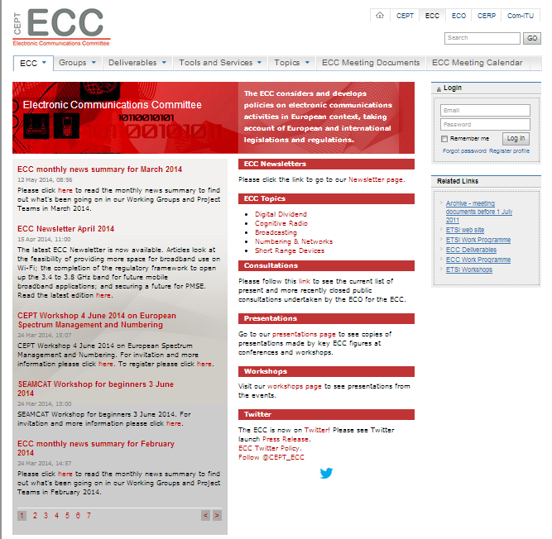
CEPT portal – ECC website
Home page: access to news.
Direct links to general information
Newsletters
Key topics
Consultations
Presentations
Workshops
Twitter
Navigation through tabs
Related links

Slide 4
CEPT portal – ECC website
ECC tab: Access to general information
ECC mission, framework and structure
Participation, MoU, LoU
Cooperation with ETSI
Newsletters
CEPT administration
National contacts

Slide 5
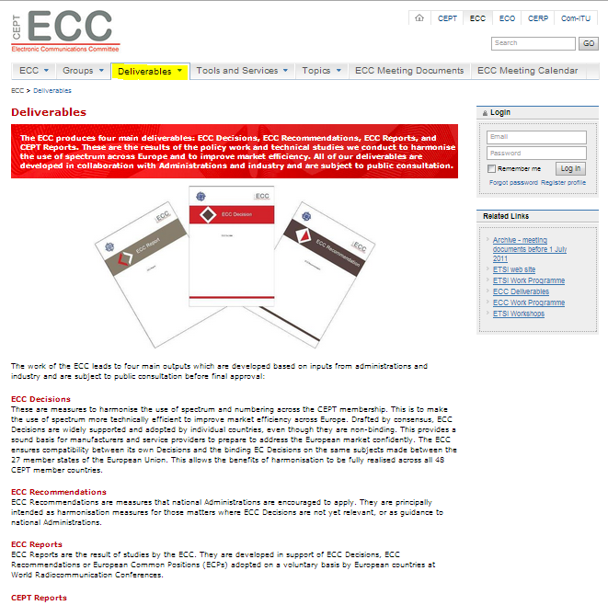
CEPT portal – ECC website
Deliverables:
Access to ECO documentation database
ECC Decision, ECC Recommendation, ECC Report, CEPT Reports
Other deliverables
ECO Reports
Agreements
ECC templates

Slide 6
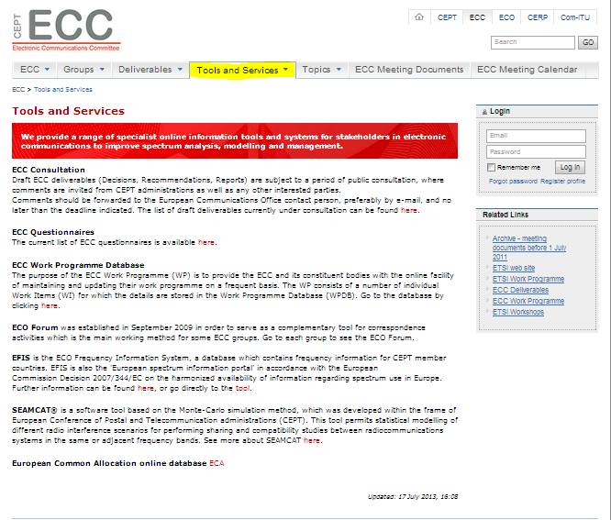
CEPT portal – ECC website
Tools and services
Access to ECO online tools
ECC work programme database
EFIS
SEAMCAT
Other services
ECC consultation
ECC questionnaires
ECO circular letters

Slide 7
CEPT portal – ECC website
Topics
Source of information on many topics
Broadcasting plans
Satellite regulatory information
Research activities
Numbering
PMSE
PPDR
Cognitive radios…
Will be updated soon

Slide 8
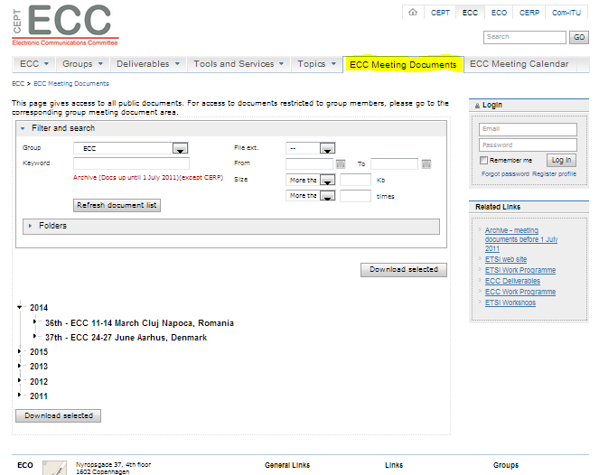
CEPT portal – ECC website
ECC Meeting documents
Gives access to all public meeting documents.
Filtering and search functions
For access to documents restricted to group members, please go to the corresponding group meeting document

Slide 9
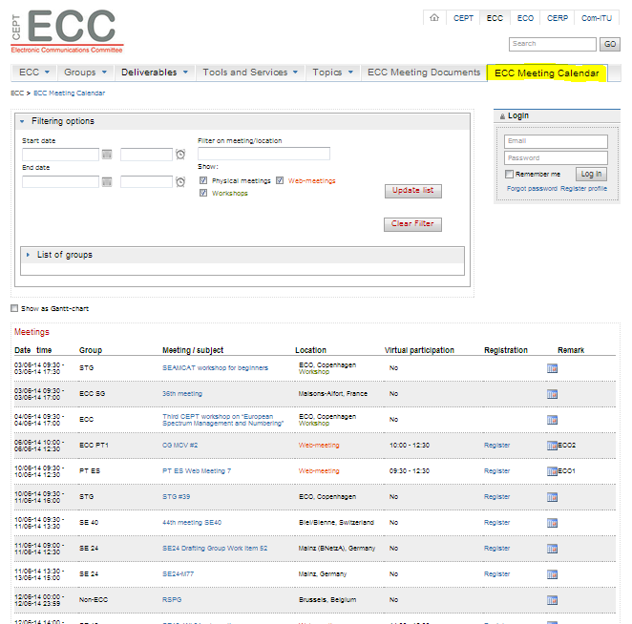
CEPT portal – ECC website
ECC Meeting calendar
Gives access to all meeting within the ECC
Includes webmeeting
Filtering and search functions
Meeting details
Registration online

Slide 10
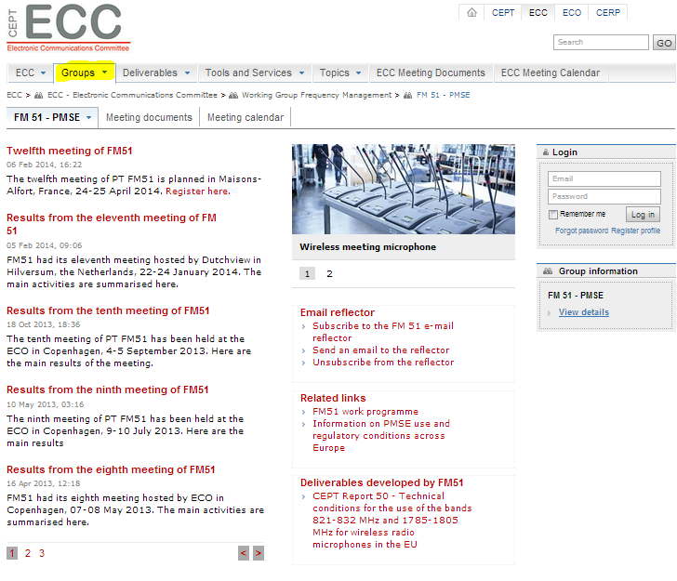
CEPT portal – ECC website
Group page
Each group within the ECC structure has its own page and framework
Group specific news
Helpful information
Meeting documents
Meeting calendar
Special feature for group members
Interested in a group? Apply for membership

Slide 11
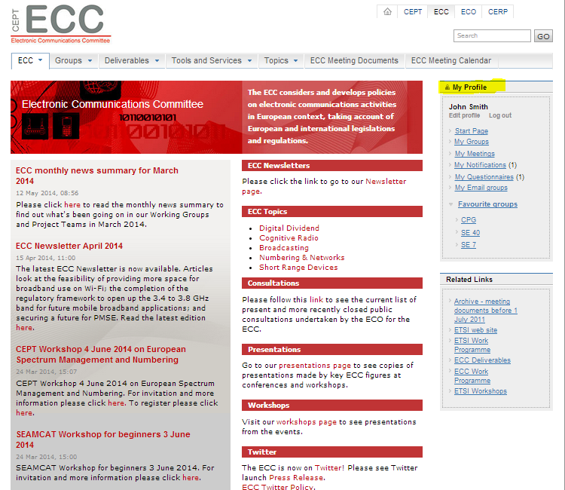
CEPT portal – logged in user
Once logged in, easy access to your important information

Slide 12
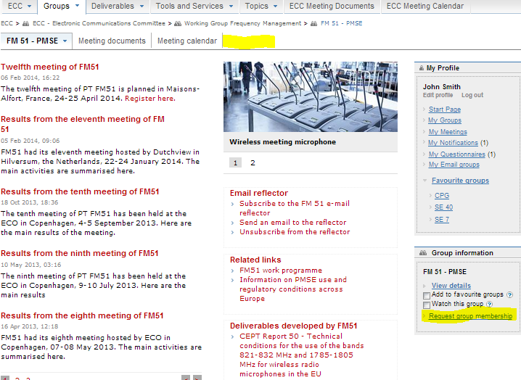
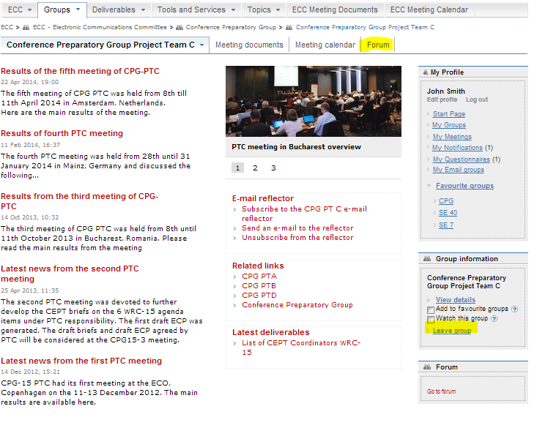
CEPT portal – group membership
Not Member
Member

Slide 13
CEPT portal – group membership
Gives you access to group restricted areas: forum, some documents
Allows filtering the information according to your interests
In the near future, email reflector based on group membership

Slide 14
Electronic working arrangements
Enhance meeting participation and efficiency.
Guidelines on the organisation and participation in web-meetings, webinars, virtual participation in meetings.
Promote use of electronic working means (email reflector, forum, electronic questionnaire) supported by the CEPT portal
Facilitated by other features provided by the CEPT portal (meeting documents, meeting management).

Slide 15
Thanks for your attention!!

